Slide 1
Omaha Public Schools
Boundary Process & Recommendations
Board Updated
august 19, 2019
Notes:
CS and OPS - Introductions

Slide 2
Agenda
    Purpose
    Process
    Community Meeting Results
    Boundary Recommendations
    Timeline & Implementation
    Student Assignment Plan
    Q & A
Notes:
CS

Slide 3
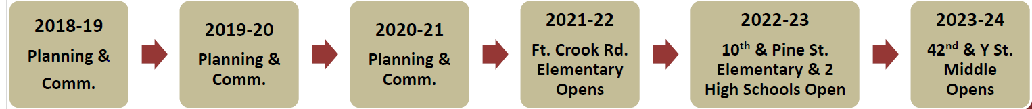
Purpose
As a result of the Bond Program, two new elementary schools, one middle school and two new high schools will be opened in the next five years.
The result of new school construction makes it necessary for the district to create boundaries for these schools. This will impact surrounding schools and have a districtwide impact at the high school level.
Tonight’s presentation is to provide the Board an update of the boundary process and present recommendations for boundary changes.
Notes:
CS

Slide 4
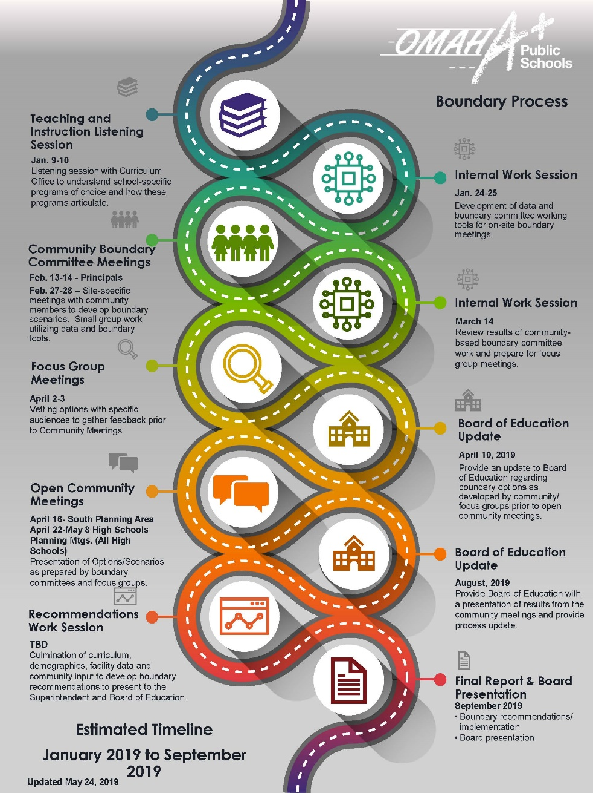
Timeline and Process
Process to Date
Meeting with curriculum to gain understanding of programs and school choice
Internal work session with OPS staff to develop data and tools for on-site boundary committee meetings
Boundary committee meetings with groups of principals, teachers and community members, utilizing boundary tools to develop boundary options
Internal work session to review feedback and options developed in boundary committee meetings and prepare for focus groups
Focus Group Meetings
Board of Education update on April 10
Open community meetings to present boundary options
Internal work sessions to create recommendations
Present recommendations to Board of Education
Notes:
CS

Slide 5
Parameters for Boundary Creation
Attempt to assign an entire elementary school boundary to a single high school/ middle school.
Attempt to balance the “proposed live-in utilization” of new and impacted schools based on school capacity.
Attempt to balance free/reduced lunch and race/ethnicity percentages of new and impacted schools.
Attempt to eliminate Bryan/South and Burke/Northwest “shared” high school attendance areas.

Slide 6
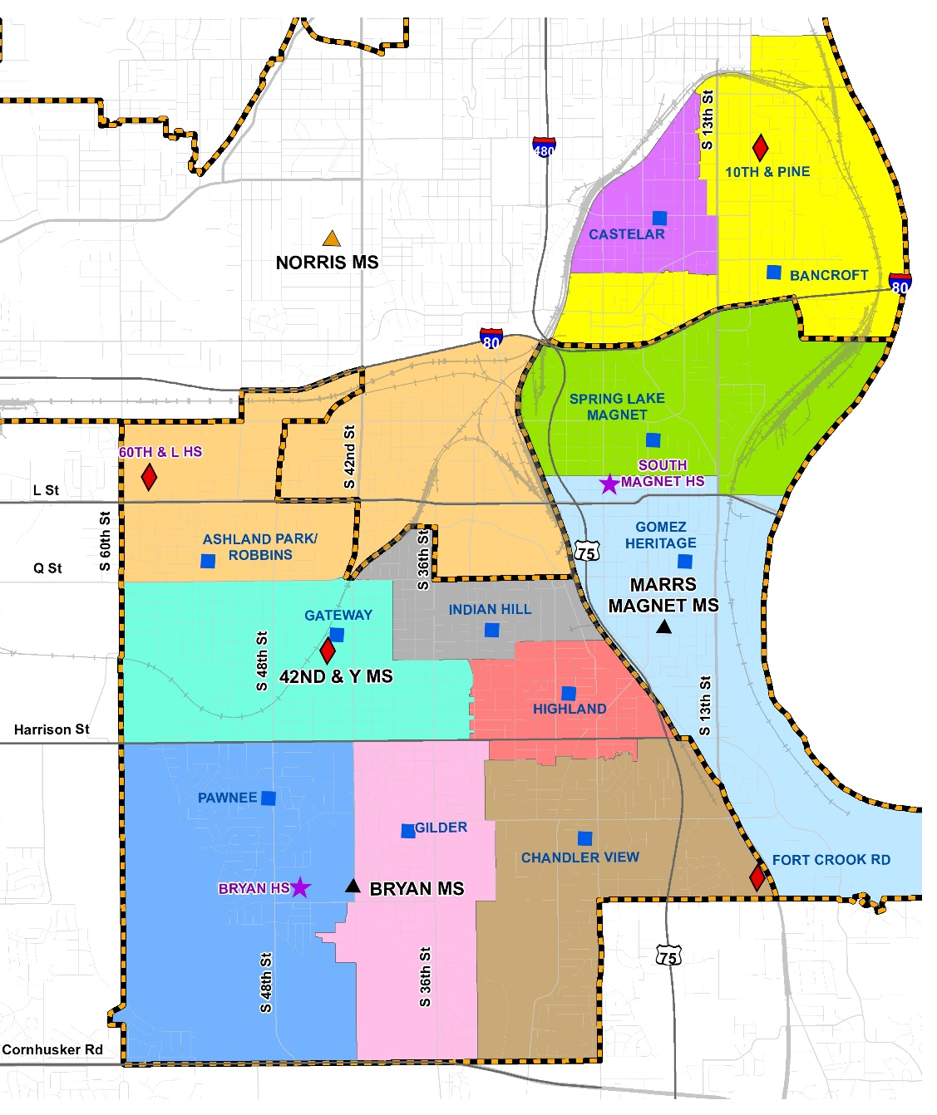
South Omaha Boundaries
Current Boundary Overview
K-5 live-in utilization ranges from 49.1% to 131.6%
One elementary school splits at middle school level
Middle school live-in utilization ranges from a low of 73% to a high of 192.1%
Notes:
OPS

Slide 7
Elementary/middle School Options
Option 1 Overview
All elementary schools feed 100% to one middle school
  Result is an imbalance in middle school utilization and new 42nd & Y middle school with a proposed live-in utilization of 98.7%
Highest number of students change their home attendance area in this option
Option 2 Overview
Three elementary schools split at the middle school level
  Result is greater balance of middle school live-in utilization
Lowest number of students change their home attendance area in this option
Option 3 Overview
Three elementary schools split at the middle school level
  Result is greater balance of middle school live-in utilization
Fewest number of middle school students change their home attendance area in this option
Notes:
CS

Slide 8
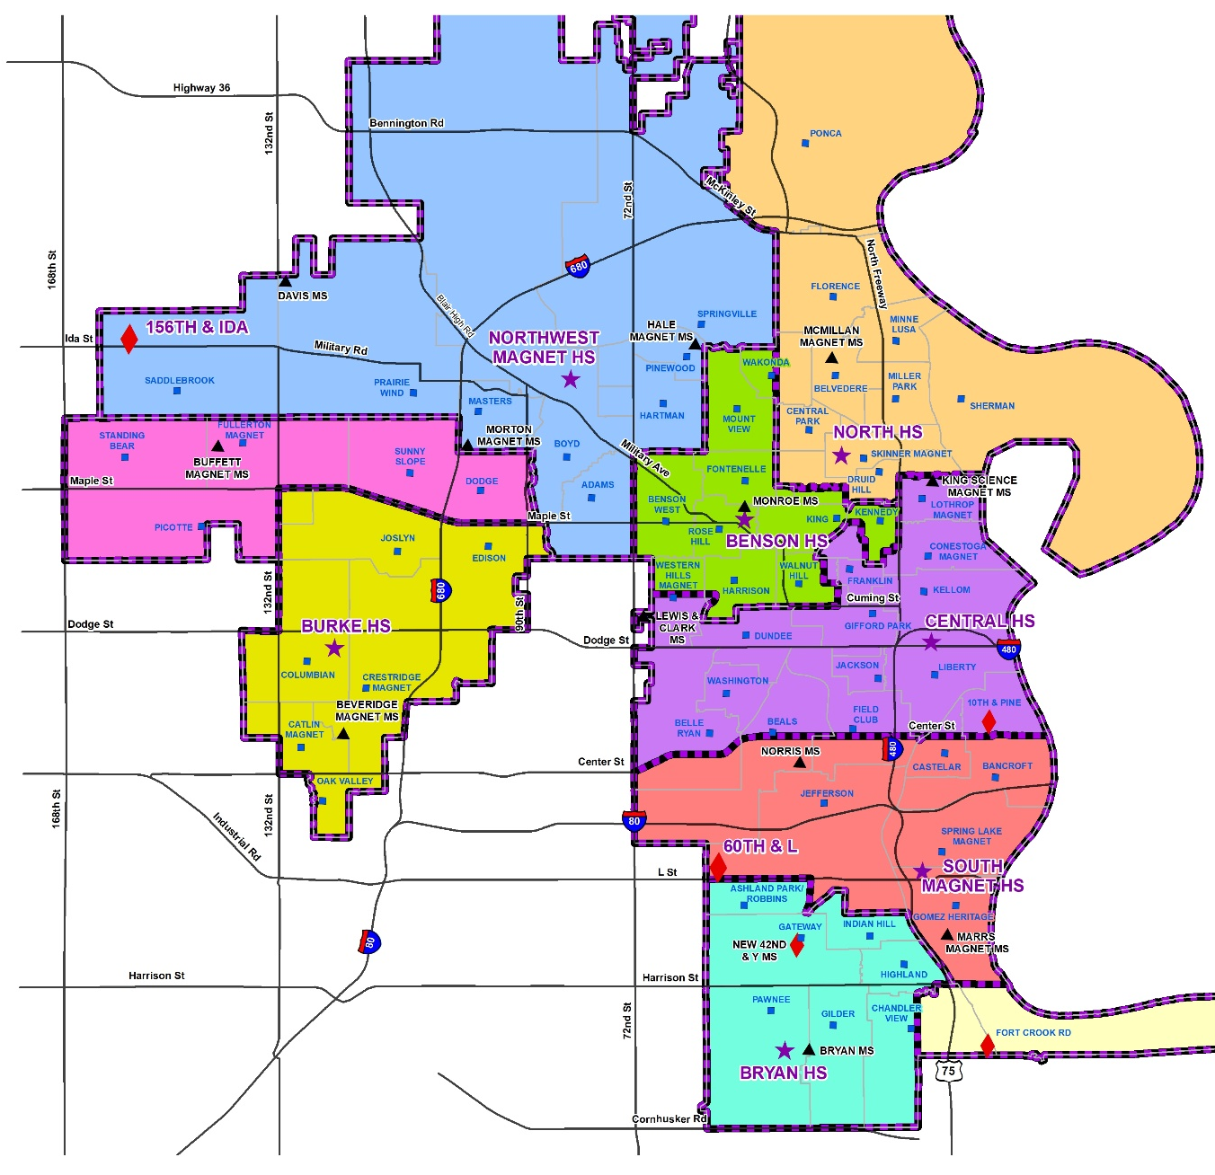
High Schools Current Boundaries
Current Boundary Overview
Current live-in utilization ranges from 38.8% to 112.2%
  1,135 students in Burke/Northwest “shared” zone not counted in either school
Current enrollment utilization ranges from 69.9% to 122.5%
Sixteen elementary school and 8 middle schools splits at the high school level
Notes:
OPS

Slide 9
High School Options
Option 1 Overview
Live-in utilization ranges from 69.6% to 86.7%
One elementary school splits at HS (Druid Hill)
Greatest balance of live-in utilization of all 3 options
Option 2 Overview
Live-in utilization ranges from 61.3% to 92.2%
Two elementary schools split at HS (Beals & Druid Hill)
Expanding 156th & Ida boundary creates live-in utilization imbalance between Burke & 156th & Ida high schools
Option 3 Overview
Live-in utilization ranges from 66.5% to 90.5%
Seven elementary schools split at HS (Bancroft, Beals, Belle Ryan, Castelar, Druid Hill, Field Club and Western Hills)
Least change to Central HS boundary as Center St. remains the dividing line
Notes:
CS

Slide 10
Community Meetings
April 16 – South Omaha elementary/middle boundary community meeting at South High Magnet (6 p.m.-8 p.m.)
April 22 – High school boundary meeting at Burke High School (6 p.m.-8 p.m.)
April 23 – High school boundary meeting at South High Magnet (6 p.m.-8 p.m.)
April 29 – High school boundary meeting at Central High School (6 p.m.-8 p.m.)
April 30 – High school boundary meeting at Northwest High Magnet (6 p.m.-8 p.m.)
May 6– High school boundary meeting at North High Magnet (6 p.m.-8 p.m.)
May 7– High school boundary meeting at Benson High Magnet (6 p.m.-8 p.m.)
May 8– High school boundary meeting at Bryan High School (6 p.m.-8 p.m.)
Notes:
CS

Slide 11
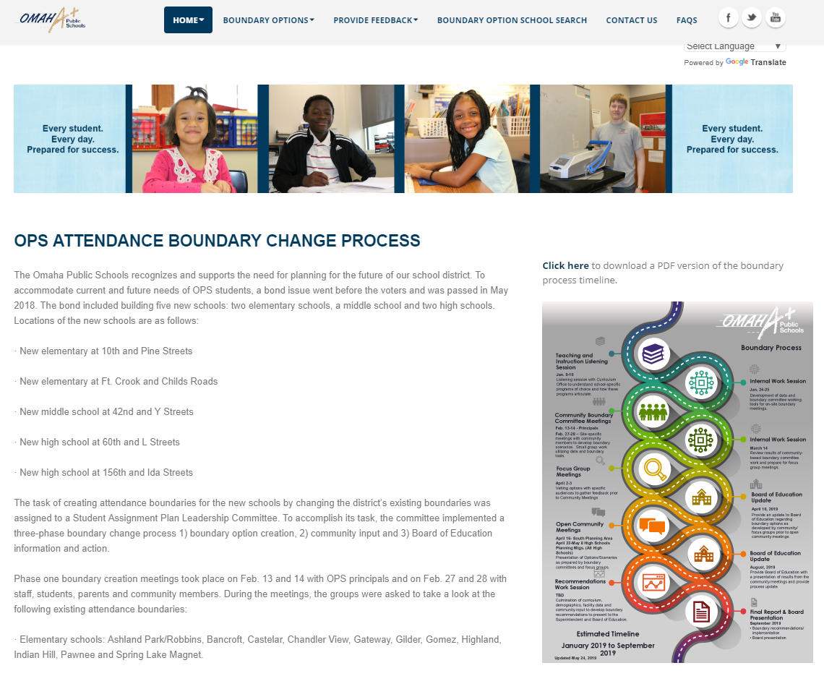
Boundary Website
OPS Attendance Boundary Change Website – boundary.ops.org
Overview of process and need to change boundaries
Links to view and download proposed options for elementary and middle schools in South Omaha and all high schools
Links to online surveys to provide feedback on proposed options
All materials available in both English and Spanish
School search tool to view your home attendance area for all boundary options presented
Notes:
CS

Slide 12
Community Meetings
South Omaha elementary/middle boundary meeting
Ten attendees on April 16th
Twenty-one online survey responses
High school boundary meetings
Approximately 275 combined attendees at seven meetings
526 online survey responses
  31 respondents did not identify a high school home attendance area
Notes:
CS

Slide 13
Recommendations Work session
Internal work session with Student Assignment Plan Committee, Cooperative Strategies and Jacobs to develop final recommendations
  Reviewed initial boundary creation group data
  Reviewed option alignment to the parameters for boundary creation
  Reviewed feedback from community meetings and online surveys
Notes:
CS

Slide 14
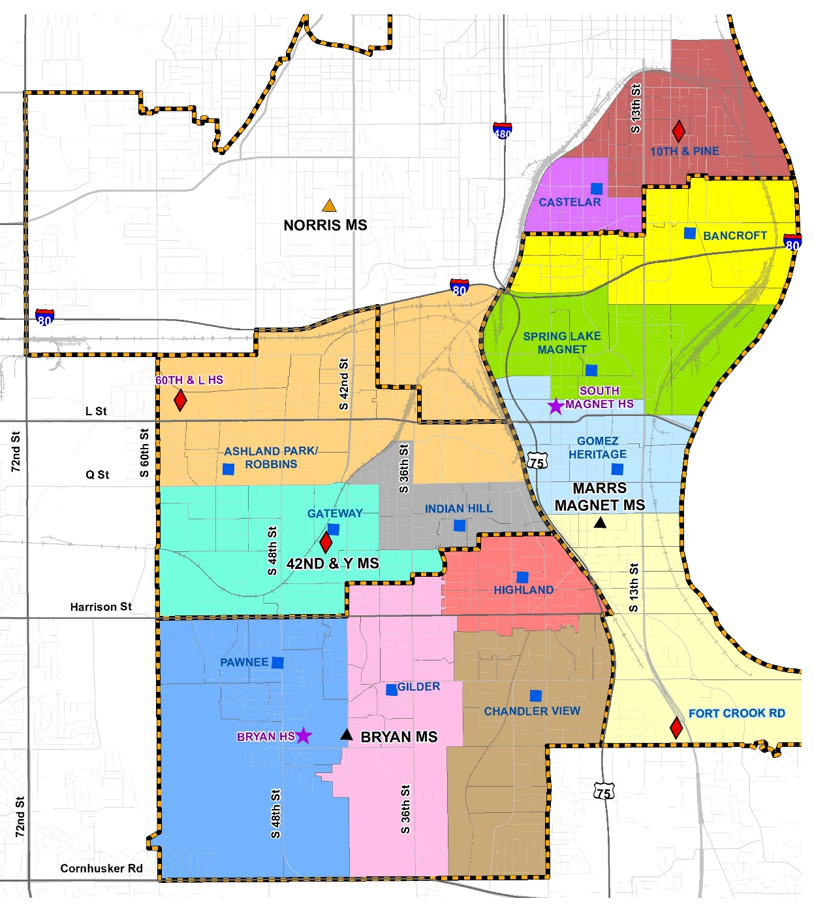
South Omaha Recommendation
South Omaha Recommendation Overview
K-5 live-in utilization ranges from 46.1% to 96.9%
One elementary school splits at middle school level
Middle school live-in utilization ranges from a low of 87.5% to a high of 97.1%
Notes:
OPS

Slide 15
South Omaha Recommendation
Notes:
OPS

Slide 16
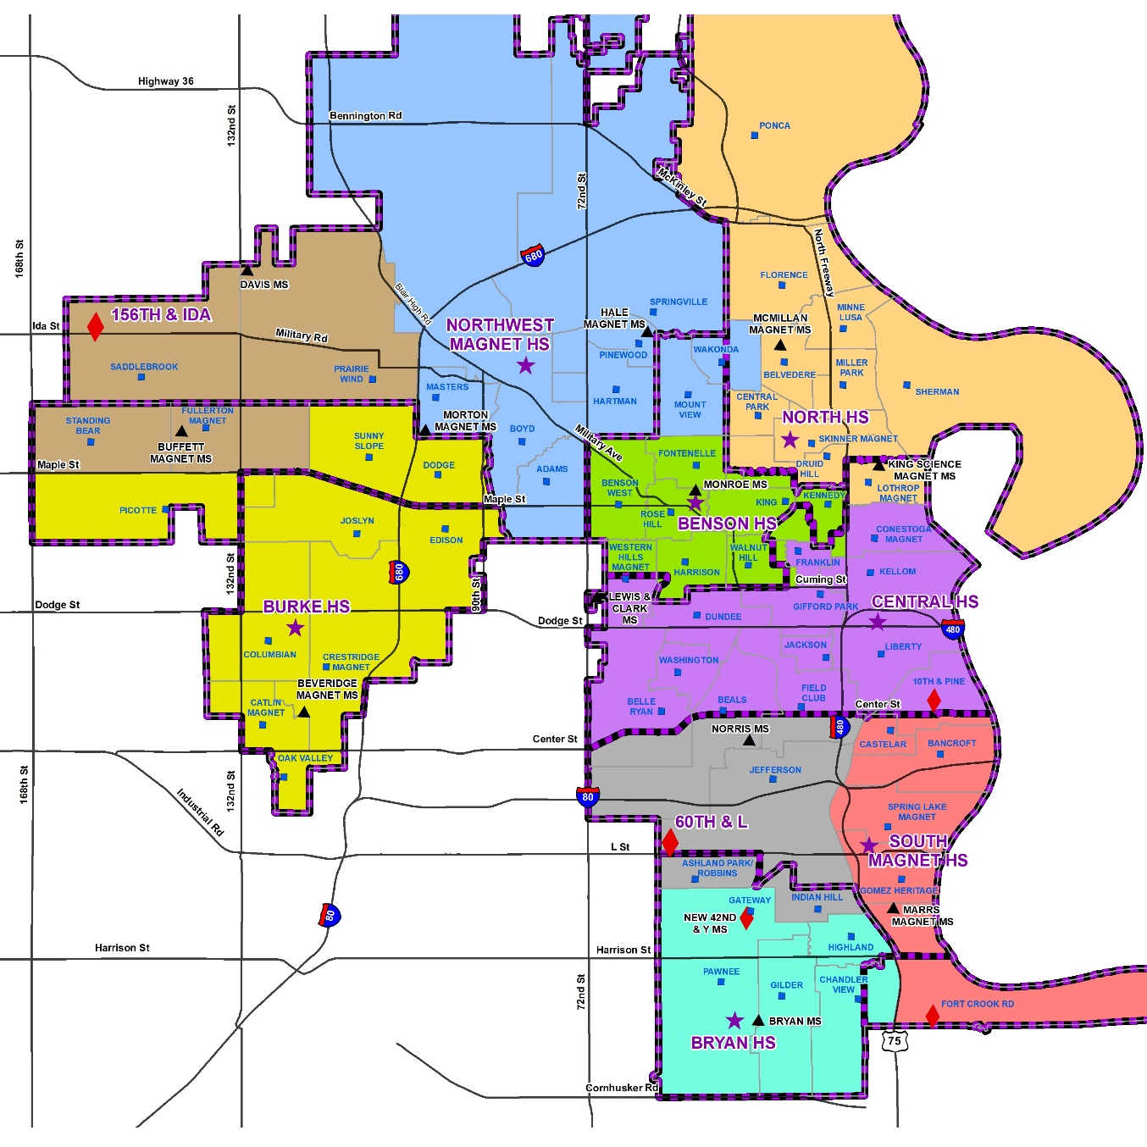
High School Recommendation
High School Recommendation Overview
Live-in utilization ranges from 67.2% to 87.1%
Shared HS attendance zones eliminated
Six elementary schools split at high school level (Beals, Belle Ryan, Druid Hill, Field Club, New 10th & Pine and Western Hills)
Eight middle schools split at the high school level
Notes:
OPS

Slide 17
High School Recommendation
Notes:
OPS

Slide 18
Boundary Timeline
2021-22
  Ft. Crook Elementary opens: change to Chandler View and Gomez Elementary attendance areas
    Opens as K-4 in 21-22
    Expands to a K-5 in 22-23
  Marrs Magnet Middle boundary change: change to Bryan Middle attendance area to align all of Ft. Crook Elementary to Marrs Magnet Middle
  Gomez Elementary boundary change: portion of Spring Lake Magnet Elementary is moved to Gomez Elementary

Slide 19
Boundary Timeline
2022-23
  10th & Pine Elementary opens: change to Bancroft and Castelar Elementary attendance areas
    Opens as K-5 in 22-23
  Norris Middle receives 6th grade from 10th & Pine (Bancroft Elementary portion)
  Bancroft Elementary boundary change: portion of Spring Lake Magnet Elementary moved to Bancroft Elementary
  Marrs Magnet Middle boundary change: change to Norris Middle attendance area to align all of Bancroft Elementary moved to Marrs Magnet Middle
  Marrs Magnet Middle transitions to 6-8
    Bancroft Elementary sends 6th grade to Marrs Magnet Middle
    Gomez Elementary add 5th grade from Marrs Magnet Middle
    Ft Crook Elementary adds 5th grade from Marrs Magnet Middle
    Spring Lake Elementary adds 5th grade form Marrs Magnet Middle

Slide 20
Boundary Timeline
2022-23
  156th & Ida High School opens: changes to Burke High and Northwest High attendance areas
    Opens as 9-10 in 22-23
  60th & L High School opens: changes to Bryan High and South High attendance areas
    Opens as 9-10 in 22-23
  Benson High Magnet boundary change: portion of Central High moved to Benson High Magnet
  North High Magnet boundary change: portion of Central High moved to North High Magnet
  Northwest High Magnet boundary change: portions of Benson High Magnet and North High Magnet moved to Northwest High Magnet
  Bryan High/South High shared boundary change: the Bryan High and South High Magnet shared area is split between both schools

Slide 21
Boundary Timeline
2023-24
  42nd & Y Middle opens: changes to Bryan Middle and Norris Middle attendance areas
    Opens as grades 6-7 in 23-24
    Expands to grades 6-8 in 24-25
  Gilder Elementary boundary change: portion of Gateway is moved to Gilder
  6th grade transitions to middle schools:
42nd & Y Middle | Norris Middle | Bryan Middle
Ashland Park/Robbins Elementary | Ashland Park/Robbins Elementary | Chandler View Elementary
Gateway Elementary |  | Gilder Elementary
Indian Hill Elementary |  | Highland Elementary
 |  | Pawnee Elementary
  6th grade transitions to middle schools: Alignment to 6-8 middle school grade configuration at Buffett Magnet Middle and King Science & Technology Magnet (Norris and Lewis & Clark cannot fully align due to physical space constraints)

Slide 22
SAP TIMELINE
Elementary Partner Zone Change
  In 2021-22, Ft. Crook Elementary is added to elementary Partner Zone 8
  In 2022-23, 10th & Pine Elementary is added to elementary Partner Zone 5
Middle School Partner Zone Change
  In 2023-24, 42nd & Y Middle is added to Partner Zone 3
  In 2023-24, Beveridge Magnet Middle is added to only Partner Zone 4 and is no longer also in Partner Zone 3
High School Student Assignment Plan
  Development: September 2019 - October 2020
  Communication November 2020 – August 2022
  Implementation in 2022-23

Slide 23
TRANSITION Strategy
Mitigate Impact of Changes by:
  Communicating early: personal notification of changes two years in advance of change to impacted families
  Communicating often: frequent outreach though various media channels
  Consistently prioritizing the needs of students and families throughout the transition process
  Begin communication in December 2019
Moving Forward
  Updated website with recommendations
  Bring recommendations as action item in September

Slide 24
Q & A
Notes:
CS and OPS - Introductions

